Slide 1



Introduction to Inheritance
Inheritance means create a new class from existing class.
•Using Inheritance , new generated class access all properties(variable & methods) of existing class.
•Inheritance define IS-A relationship(parent-child relationship) of class.
•Existing class known as parent class/base class/super class.
•New generated class known as child class/derived class/sub class.
•Inheritance are creating by “extends” keyword.
•Using inheritance, parent class properties and child class properties always call by child class objects.
VRUND PATEL
23000054

Slide 2

Inheritance Basics
Inheritance is a fundamental concept in object-oriented programming that allows a derived class to inherit properties and methods from a base class.
The derived class is known as the subclass, while the base class is known as the superclass.
Inheritance promotes code reuse and hierarchical organization of classes, making the code more modular and maintainable.

Slide 3

Types of Inheritance
In Java, there are several types of inheritance that allow classes to inherit attributes and methods from parent classes. The main types include single inheritance, multilevel inheritance, hierarchical inheritance, and multiple inheritance (with some limitations).
Each type of inheritance has its own unique characteristics and use cases, allowing developers to model complex relationships between classes and reuse code effectively.

Slide 4
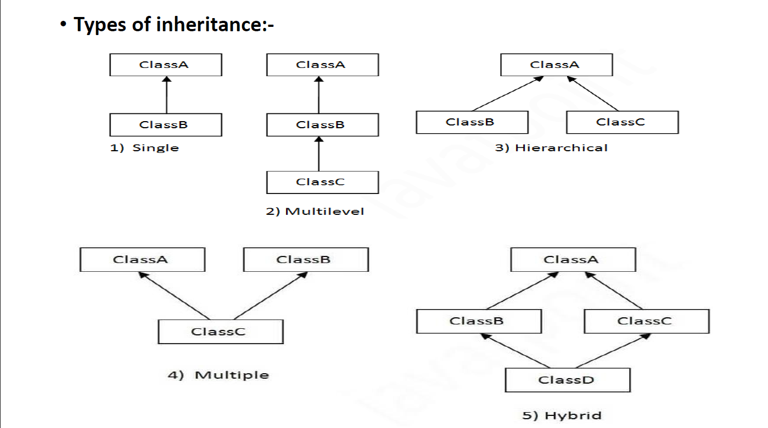

Slide 5
Single Inheritance
Definition
1
Single inheritance is a fundamental concept in object-oriented programming where a subclass inherits properties and methods from a single superclass.
2
Key Characteristics
In single inheritance, a subclass can only have one direct superclass, forming a simple parent-child relationship in the class hierarchy.
Advantages
3
Single inheritance promotes code reuse, simplifies class design, and makes the inheritance hierarchy easier to understand and maintain.

Slide 6
Multilevel Inheritance
Parent Class
1
Base class
Child Class
2
Derived from parent
Grandchild Class
3
Derived from child
Multilevel inheritance in Java allows a derived class to inherit from a base class, which in turn inherits from another base class. This creates a hierarchy where the derived class has access to members from multiple levels of inheritance. This powerful feature enables code reuse and hierarchical organization of classes.

Slide 7

Hierarchical Inheritance
Hierarchical inheritance is a type of inheritance where a single parent class has multiple child classes. This allows for the reuse of code and the creation of a hierarchy of related classes.
In Java, hierarchical inheritance is achieved using the 'extends' keyword. The parent class provides common functionality and fields to its child classes, which can then specialize and add their own unique features.

Slide 8

Multiple Inheritance
Java does not support multiple inheritance of classes, but it does allow for multiple inheritance of interfaces. This means a class can implement multiple interfaces, gaining access to the methods and fields defined in those interfaces.
While this can lead to powerful code reuse, it also introduces potential complications around method name conflicts that must be carefully managed.

Slide 9
interface FirstInterface {
public void doSomething();
}
interface SecondInterface {
public void doSomethingElse();
}
class DemoClass implements FirstInterface, SecondInterface {
public void doSomething() {
System.out.println("Doing something...");
}
public void doSomethingElse() {
System.out.println("Doing something else...");
}
public static void main(String[] args) {
DemoClass obj = new DemoClass();
obj.doSomething();
obj.doSomethingElse();
}
}

Slide 10
Doing something...
Doing something else...
OUTPUT :-
The output shows that both methods of the DemoClass class were called and printed their respective messages to the console.
Is this conversation helpful

Slide 11
Conclusion and Key Takeaways
1
Inheritance Enhances Reusability
2
Hierarchical Code Structure
Inheritance allows you to create new classes based on existing ones, promoting code reuse and reducing development time.
The different types of inheritance, like single, multilevel, and hierarchical, enable a structured and organized class hierarchy.
3
Polymorphism and Flexibility
4
Efficient Design and Maintenance
Inheritance supports polymorphism, allowing objects to take on multiple forms and adapt to changing requirements.
Inheritance encourages modular and scalable code design, facilitating easier maintenance and updates over the long term.

Slide 12

Conclusion and Key Takeaways
In this presentation, we've explored the powerful concept of inheritance in Java. From the foundational principles to the various types of inheritance, we've gained a comprehensive understanding of this essential object-oriented programming technique.

Slide 13
Inheritance in Java: Key Concepts
Inheritance Basics
Code Reuse
Polymorphism
Method Overriding
Inheritance promotes code reuse by allowing classes to share common code, reducing duplication and making the codebase more maintainable.
Inheritance enables polymorphism, which allows objects of different classes to be treated as objects of a common superclass, providing flexibility and extensibility.
Inheritance is a fundamental concept in Object-Oriented Programming (OOP) where a new class is created based on an existing class. The new class inherits the properties and methods of the parent class.
Inheritance allows subclasses to override methods of the parent class, enabling dynamic behavior and customization.

